Slide 1
Organize, Compile, and Archive Your Family Memories Using The Cloud
Adam Kerr
https://github.com/adamrkerr/MovieMakerHelper/

Slide 2
We’ve all been there…
Are your family memories stored on a dusty SSD, sitting in a desk drawer?
Do you have to coordinate files from many devices – multiple phones, the DSLR, video camera, shares from family?
Physical backups are still a good idea, but remain a single point of failure
This is my pet project…
https://github.com/adamrkerr/MovieMakerHelper
https://github.com/adamrkerr/MovieMakerHelper

Slide 3
Step 1: On-sit Backup
Program: FileCopier (For quickly pulling from phones)
I still back everything up to a mil-spec SSD
Try to put everything in folders by device and year, which makes it easy to know what has already been done
https://github.com/adamrkerr/MovieMakerHelper

Slide 4
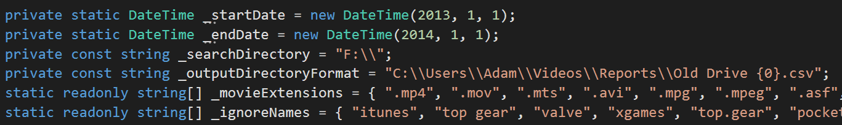
Step 2: Catalog
Program: FileCataloger
Crawls the drive for files
Note the “ignore list” for directories and extensions
Creates a report (csv) which drives the uploader
This allow manual data verification before upload
Organized by date
De-duplication is attempted
https://github.com/adamrkerr/MovieMakerHelper

Slide 5
Step 2 Continued: File Metadata
Figure out the date of the file
Modified date
Created date (sometimes this is incorrect after a file is copied)
File name (YYYYMMDD_HHmmss)
File name always wins, so that you can force a correct date by renaming the file
Uses DirectX to pull data about the video (resolution, etc)
Can continue on error, or comment out this part.
Checks for duplicates based on date and file size
https://github.com/adamrkerr/MovieMakerHelper

Slide 6
Step 3: Upload
Program: FileUploader
Using the csv generated from FileCataloger, uploads files to AWS S3
Given a bucket, separates files into subdirectories by year and month
Tags each file with orginal file date, location on disk, and video metadata
Creates another output csv with results of each file upload
This is useful if the upload stops before completion
Also notes if an individual file fails
https://github.com/adamrkerr/MovieMakerHelper

Slide 7
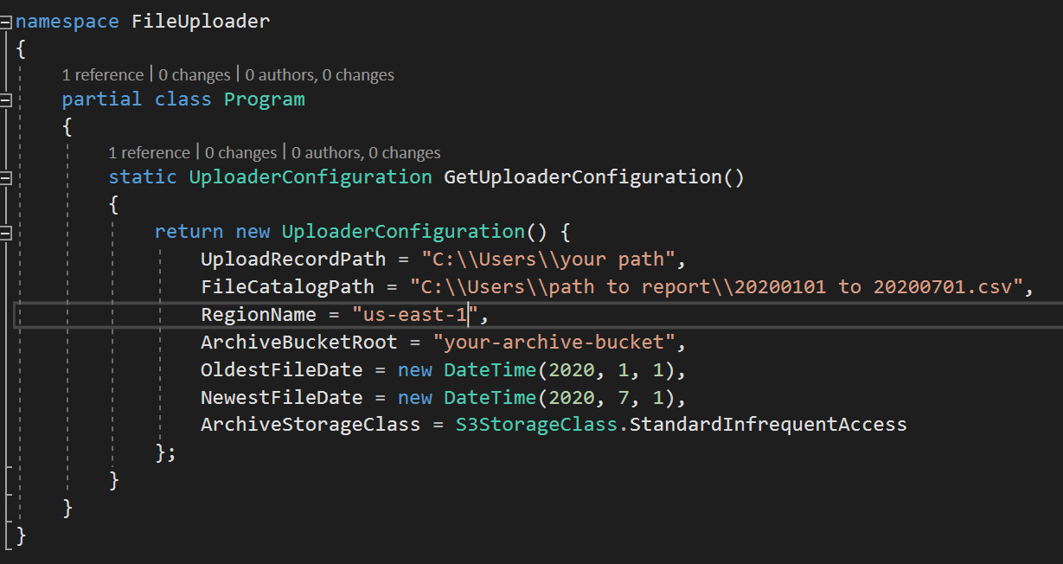
Step 3: Secrets
https://github.com/adamrkerr/MovieMakerHelper

Slide 8
Step 4: Convert
Program: TranscoderEnqueuer
Scans S3 for files for a given month and year
Generates subtitle files for each unique date
Just a text file - .srt
Output resolution is configurable
Impacts cost and file size
Submits the job to AWS MediaConvert
AWS auto-rotates and converts
Drops completed videos into another AWS bucket
https://github.com/adamrkerr/MovieMakerHelper

Slide 9
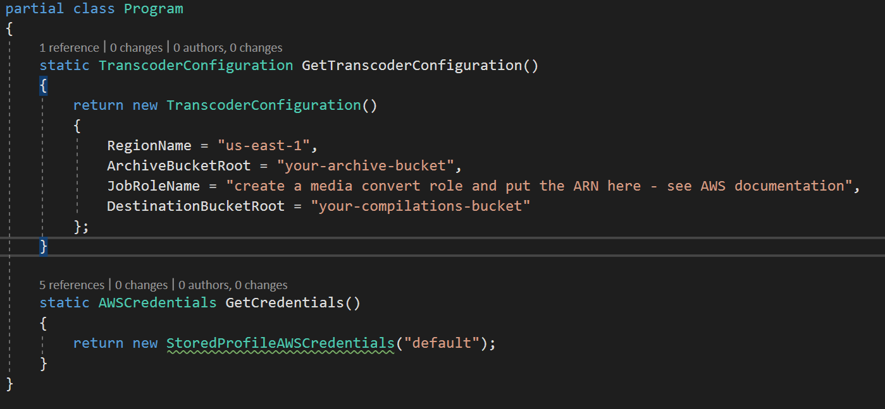
Step 4: Secrets
https://github.com/adamrkerr/MovieMakerHelper

Slide 10
Step 5: Archive
Program: TranscoderEnqueuer
Secondary function – can convert S3 files to Glacier
$0.004 fer GB, per month, but must pay for retrieval
Archive the files once you know you won’t need them again
https://github.com/adamrkerr/MovieMakerHelper

